Slide 1
STAT7001 – Computing for Practical Statistics 2015 Lecture 1
An Introduction to the R Statistical Software Suite
Dr Franz J. Király

Slide 2
Scope of the course
Computing for Practical Statistics
How to do Statistics when you have actual data
Computing for Practical Statistics
How to do Statistics with a computer (R and SAS)
Computing for Practical Statistics
How to understand and explain what you are doing
How to interpret and contextualize your results

Slide 3

Here is a table with words and numbers.
You’re a statistician, aren’t you?
Write me a report until next week on what you see in it.
(in particular on how I can earn more money from it)

Slide 4
Course organization
On-line course moodle ID 29155
on-line activities (voting, forum, feedback), course info and materials
Lecture Mondays, 2 - 3 pm
Attendance is non-compulsory
First lecture Jan 12, last lecture Mar 23 (no lecture in reading week)
Slides and course script available on moodle
Lecture is videotaped and availble on Lecturecast/moodle
Workshops
Tuesday, 2 - 5pm Torrington 1-19 room 113
Friday, 11am - 2pm Birkbeck Malet St room 109
Attendance at one of the two workshops is compulsory
Tuesday workshop for Stats students, Friday for Math & other students
You can opt for switching on moodle (until today, 6 pm)

Slide 5
Course organization
ICA two take-home projects
Handing out: Jan 19, Feb 16 Submission: Feb 16, Mar 16
Each take-home ICA counts 50% towards final grade
usual regulations for late submissions and extenuating circumstances apply
The content is small projects that you could encounter in real life
(with some help via formulated exercise questions)
The projects are group work in groups of 2 or 3
Groups are uniformly randomized, under the constraints that:
every group has 2 or 3 members
groups should contain one stats and one non-stats student
no student is in a group of 2 for both ICA
no pair of students is in the same group for both ICA
So it can happen that not all group members attend the same workshop.
This is fine as the workshop is for individual teaching.
Questions about the group project should be asked in the forum (or during office hours)

Slide 6

STAT7001 course overview
DATA
Scientific Questions
R
SAS
Lectures 4,10
Methods
Exploration
Statistical Questions
The Scientific Method
Programming Skills
Lecture 2
Quantitative Modelling
Lectures 7,8
Lectures 3,5,7,9
Lect. 2,3,4, 7,10
Lect. 1,6,8
Descriptive/Explanatory
Predictive/Inferential
Scientific and Statistical Validation
Lect. 3,4,7,9
Knowledge

Slide 7
Programming
STAT7001: Thematic table of contents
Lecture 1: Introduction to R
Lecture 6: Introduction to SAS
Lecture 8: Custom Routines and Optimization
Statistical Methods
Lecture 2: Exploratory Data Analysis
Lectures 3,5,9: Parametric Model Fitting, ANOVA
Lecture 7: Parametric Estimation
Data Analysis Methodology
Lecture 3: Predictive Modelling
Lecture 4,10: Principles of Data Analysis
Lectures 7,8: Simulation and Method Validation
Lectures 9,10: Model Selection

Slide 8
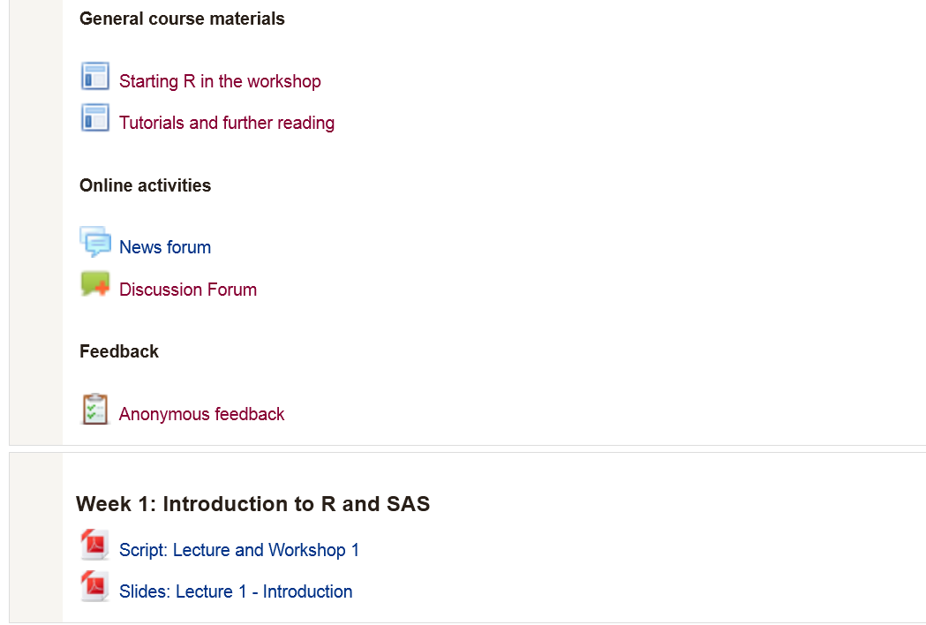
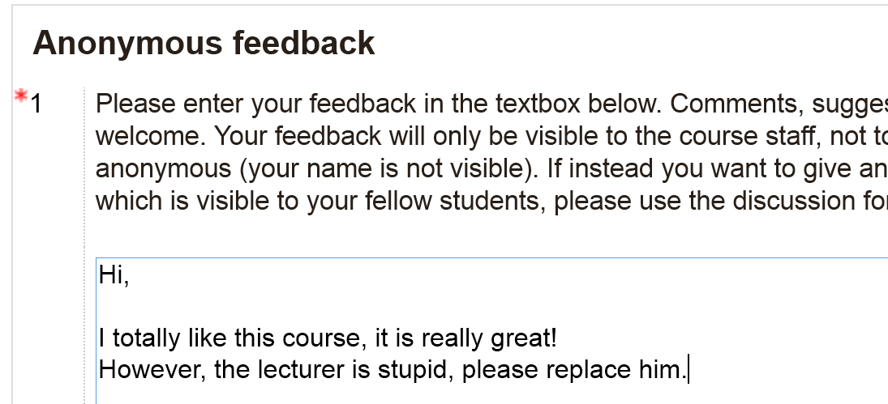
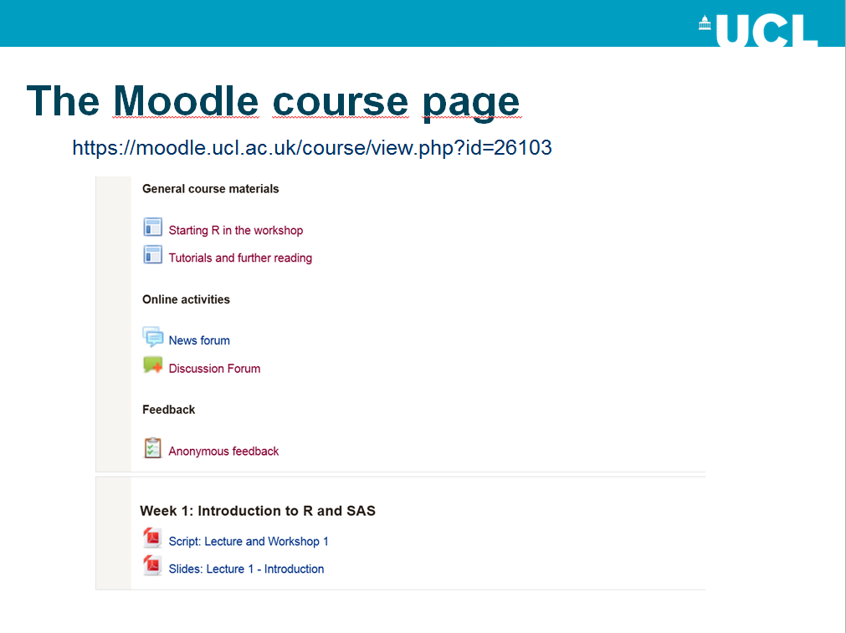
The Moodle course page
https://moodle.ucl.ac.uk/course/view.php?id=29155

Slide 9
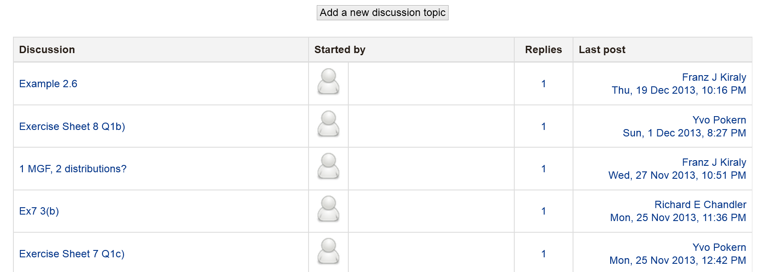
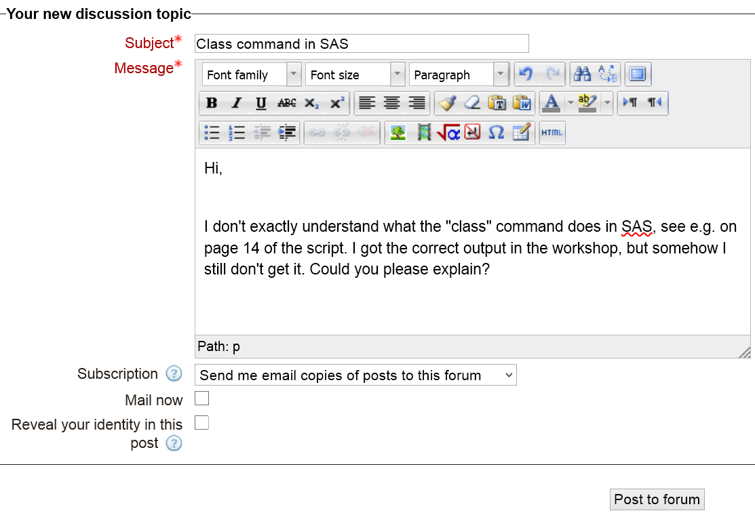
The Moodle course page
https://moodle.ucl.ac.uk/course/view.php?id=26103

Slide 10
The „optimal“ learning cycle
(1) attend the lecture, or watch lecturecast
So you understand the basic concepts
(2) read the workshop script
So you have an idea what you will be doing at the workshop
(3) attend the workshop
Try to follow the presented
Ask instructors if you cannot figure out why it doesn‘t work
(*) At each step: read or write in the forum
For any questions on stats, computing, or general understanding
Ask in order to make efficient use of your learning time
Really helpful and you cannot do anything wrong. Look at the 2014 forum!

Slide 11
An Introduction to R

Slide 12
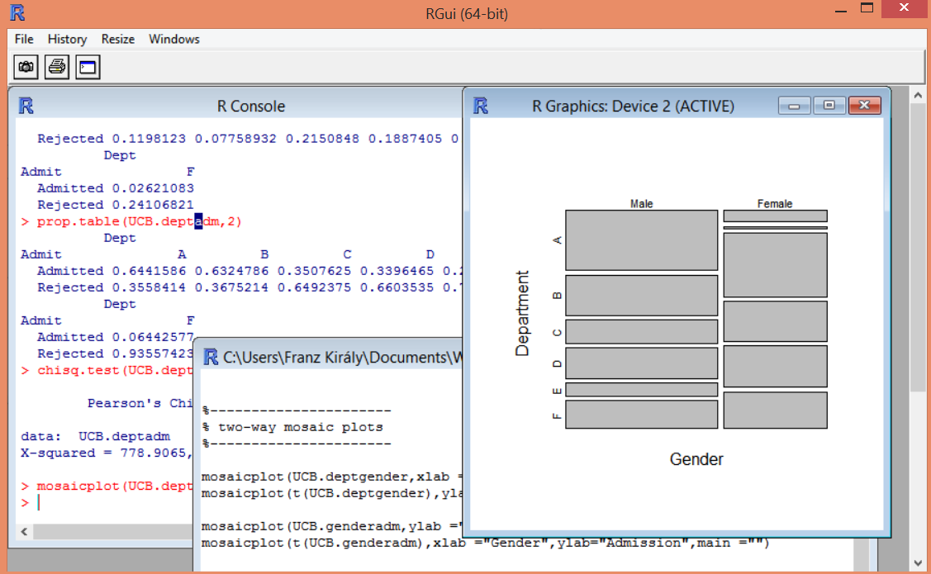
R
Command language suite with graphical interface
Increasing usage for professional data analysis tasks
Originated at University of Auckland; public and collaborative project (GNU GPL)
a typical data analytics session in R:
output window „console“
graphics/plot window
code/script window

Slide 13
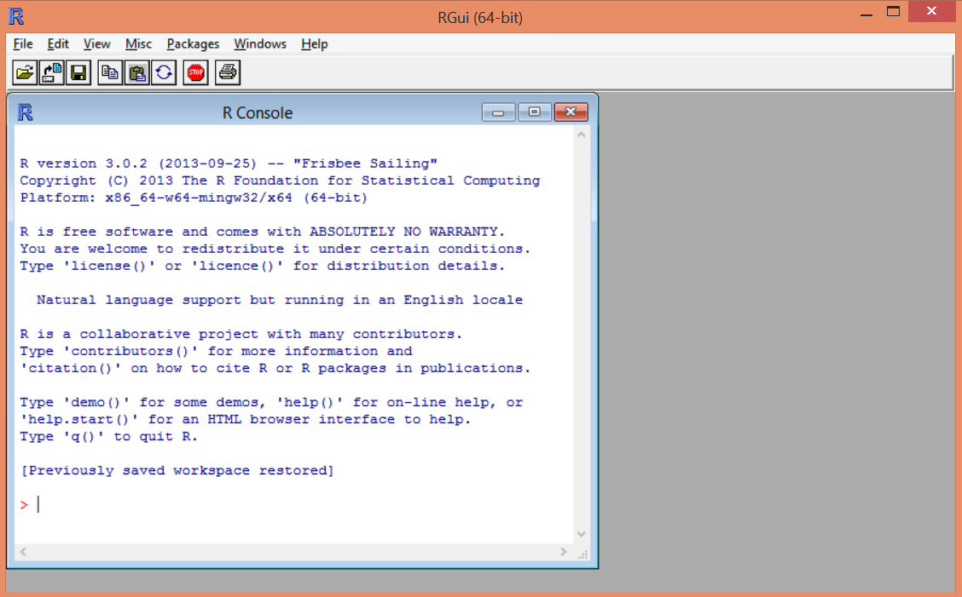
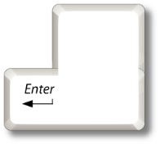
How to work with R
R Gui for Windows after you start the software suite
there is no script or plot window when you start R.
plot windows are opened by typing plotting commands
script windows store your code opened by File/New script
or File/Open script
type commands here, execute with
In the lecture, commands are typeset like this instead of

Slide 14

Using the R console
R understands a variety of basic commands.
1+1
1+1;2*2
(2+5)^42
TRUE & FALSE
by default, R uses 7-digit E-notation
Commands are concatenated by a semicolon ;
Arithmetic operations and symbols in R
+
addition
-
subtraction
*
multiplication
/
division (exact)
(…)
brackets
^
exponentiation
%/%
integer division
%%
remainder
Boolean/logical symbols in R
T
TRUE
true
F
FALSE
false
(…)
brackets
!
negation - „not“
&
conjunction – „and“
|
disjunction – „or“
this is the „pipe“ or „vertical bar“|, not the letters I or l
R also understands words, so-called strings:
"supercalifragilistic"
"FALSE"
the " " distinguish the string from fixed expressions such as FALSE

Slide 15

Variables and the workspace
workspace
Variables are assigned by <- or =
twotimestwo <- 2*2
4
or
twotimestwo = 2*2
twotimestwo
they can later be referenced by their name
numeric
twotimestwo
eight <- 2*twotimestwo
8
or overwritten
eight
answer <- eight*5 - 2
numeric
answer <- answer + twotimestwo
variables are stored in the „workspace“
38
42
where every variable has a type
answer
and which is cleared at every restart
numeric
for reproducibility, it is good style to save not the workspace but the code that generated it

Slide 16
Primitive classes in R
= simple variable types
scientific type
scope/meaning
R class
example values
Logical
values Yes/No
logical
TRUE
FALSE
e.g. [married], [dead], [isPrimeNumber]
Nominal
values without obvious ordering
factor
"London"
"Kiraly"
e.g. [PlaceOfBirth], [Sex] [LastName]
"Ice Cream"
Ordinal
values with intrinsic ordering
"A+"
"large"
ordered
e.g. [HighestDegree], [SatisfactionLevel]
"V.S.O.P."
Interval
numbers without natural zero point
e.g. [Date], [TimeOfDay], [Energy]
0
1
numeric
Absolute/ Proportional
numbers with natural zero point
42
pi
e.g. [Price], [Speed], [Duration]
NA
Any type of variable can have a special value for „missing“:
e.g. „unknown“ „unspecified“ „not available“
numeric variables have an additional state for „undefined“:
NaN
e.g. „divide by zero“ „infinity“ „does not converge“

Slide 17



Composite objects in R
R understands a variety of objects that are made up of the primitives
Vectors are defined explicitly via c() or by specifying range via the colon :
vec<-c(2,3,4)
or
vec<-2:4
or
vec<-c(2:3,4)
Entries are selected by an index vector in […]
vec[2]
vec[2:3]
vec[c(1,3)]
or by a logical vector
vec[c(T,F,T)]
Matrices are obtained from vectors via the matrix constructor
mat<-matrix(c(2,3,4,5,6,7),nrow=2,ncol=3)
Entries are accessed by […,…]
mat[1,2]
mat[2,2:3]
mat[,1]
Specifying an empty index vector is a short way of selecting all indices
Rows/column indices are removed by minus -
mat[,-2]
Matrix multiplication is %*%
mat%*%vec
Vectors and matrices can contain any primitive, but only entries of the same class
Lists can contain different primitives and are constructed by list(…) (not today)

Slide 18
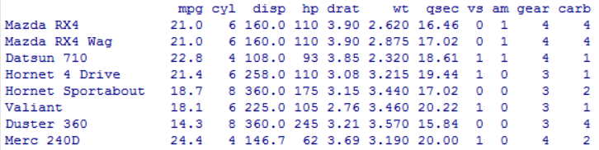

Data frames are data matrices where rows/columns have names, and columns have different classes
Example: Motor Trend Car Road Tests data set
mtcars
numeric
factor
(this is available in vanilla R)
columns = different kinds of observations
colnames(mtcars)
rows = different data points
rownames(mtcars)
Sub-data-frames can be selected just as sub-matrices, e.g.
mtcars[31,2:4]
Additionally, with vectors of row/column names
mtcars["Maserati Bora",c("cyl","disp","hp")]
Columns can be selected via dollar $, for example
mtcars$cyl

Slide 19







Functions in
Programming
Mathematics
outputY <- functionF(inputX)
Intuition:
Input
Function f, functionF
Output
inputX
outputY
every function has a specific input/output signature, for example:
inputX is a string
functions can have parameters such as
functionF(input1,input2,paramN)
an example of a function in R:
cor takes a numeric matrix/data frame and computes correlation matrix
cor(mtcars[,2:4], method = "pearson")
(method is an optional parameter set via = )
(cor(mtcars[2:4]) also works)
To get the output matrix as a variable in the workspace:
corrmat<-cor(mtcars[,2:4], method = "pearson")

Slide 20
Summary functions in R
for most objects:
summary(dataframe)
R functions
Logical
absolute and relative frequencies
table
ftable
how many entries for certain value
prop.table
principal modes
margin.table
Nominal
which values are most/least frequent
xtabs
Ordinal
quantiles: median, min/max, quartiles
fivenum
quantile
Value for which X% are smaller/bigger
min
max
median
mean, (co)variance, moments
mean
cov
cor
Interval
mean = Center-of-mass, Var. = scatter
var
princomp
principal comp. = directions of max. var.
Absolute/ Proportional
library(moments)
geometric mean, log-moments
library(psych)
(these are rarely used)
Use the help function to learn what these functions do:
help(mean) etc

Slide 21
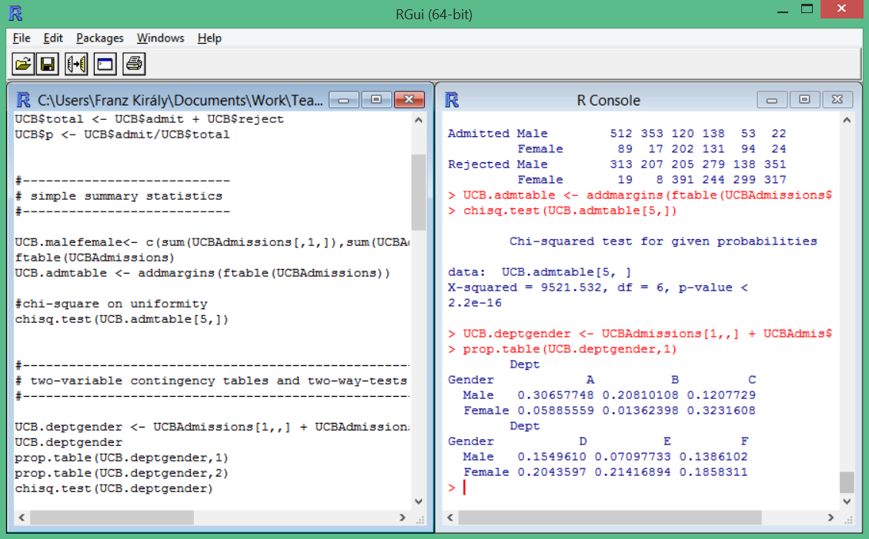
Four workflow tipps for data analysis with R
1. type your code in a script window, then send-execute to console
2. comment your code well (lines starting with # are ignored by R)
3. save and backup your scripts frequently in straightforward locations
„save script“ button
„send to console“ button
straightforward location
comment lines
script window
console

Slide 22
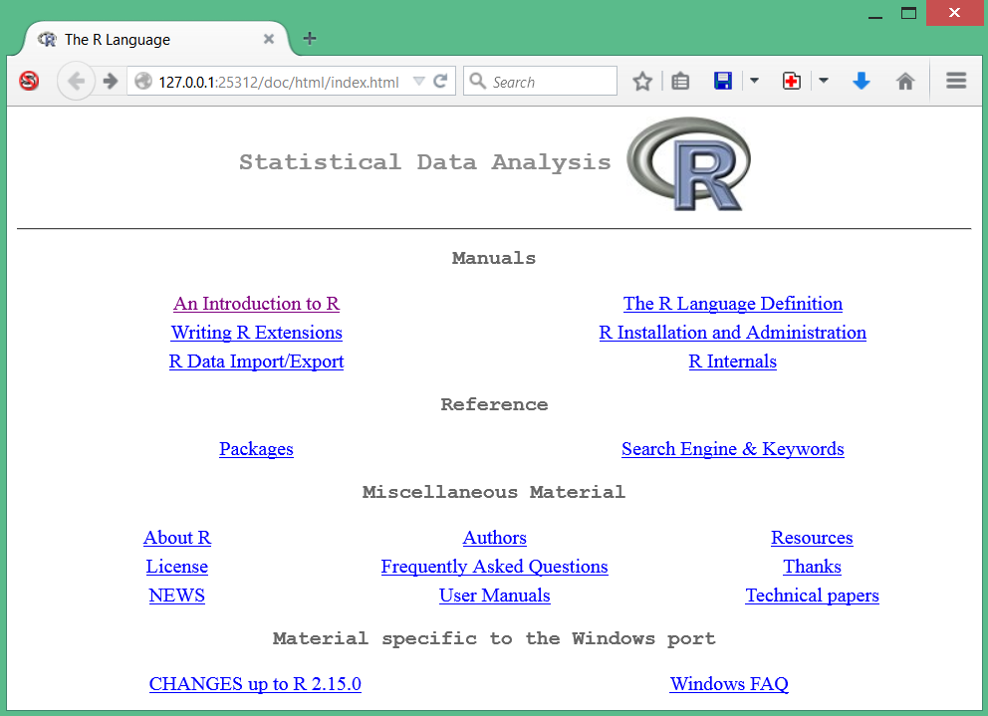
Four workflow tipps for data analysis with R
4. use the built-in R on-line help system
The object help refers to the help system
help.start() opens the table of contents as a local webpage
Click this link for a more detailed introduction to R
help(objectname) opens the documentation on objectname
for example help(mean) or help(cov)

Slide 23
How to start R in the cluster rooms
Via the Windows Start Menu/Programs/Apps/R
You cannot write to C:, so you have to setup your save directories
Our instructors will give you a walkthrough
How to start R over the web
Start a cluster WTS session, log in with UCL account
R is found under Start Menu/Programs/Apps/R
How to obtain R for home use
Download from R project webpage/CRAN mirror
http://www.r-project.org
R is free software, so no licence/authentification is needed
we recommend local installation above WTS due to occasional problems

Slide 24
Week 1 Learning Objectives
Establish a learning routine
Learn about lecture and workshop schedule
Explore moodle, lecturecast and the forum
Get familiar with the basic concepts in R
Understand variables, classes, and the workspace
Understand vectors, matrices and data frames
Understand functions and how to use them
Learn how to work with R
Run and set up R in the cluster room
Understand the console, scripts, save/load
Learn how to use the help function in R efficiently

